Slide 1
LibreOffice Python Part 3
Shared Python Script
Part 2 stored the Python script in the Users account home folder. The python script can only be accessed by one User.
In Part 3 the Python script is stored in a system folder so that it is shared to all Users on the computer system.
Hamilton Python User Group Presentation
2015 April 13
Ian Stewart
V1.0
https://github.com/hampug

Slide 2
Shared system wide python program file section....
Python script “pushbutton.py” that contains functions pushbutton() and clear() is located in a Users account...
~/==> ls -l ~/.config/libreoffice/4/user/Scripts/python/
total 4
-rw-rw-r-- 1 ian ian 2112 Apr 3 23:16 pushbutton.py
Shared Python scripts for LibreOffice are located in...
~/==> ls -lR /usr/lib/libreoffice/share/Scripts/python
/usr/lib/libreoffice/share/Scripts/python:
total 12
-rw-r--r-- 1 root root 3333 Oct 16 13:25 Capitalise.py
-rw-r--r-- 1 root root 1539 Oct 16 13:25 HelloWorld.py
drwxr-xr-x 2 root root 4096 Jan 2 19:04 pythonSamples
/usr/lib/libreoffice/share/Scripts/python/pythonSamples:
total 8
-rw-r--r-- 1 root root 4491 Oct 16 13:25 TableSample.py

Slide 3
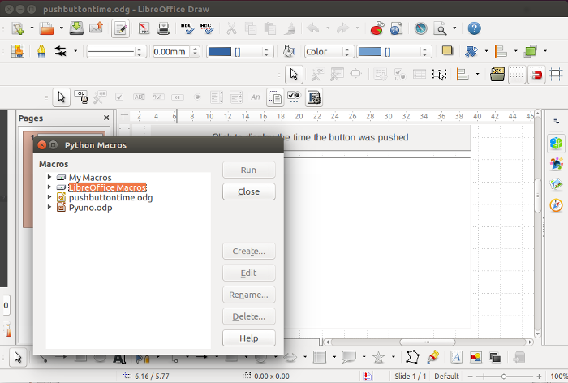
Review the shared macro's...

Slide 4
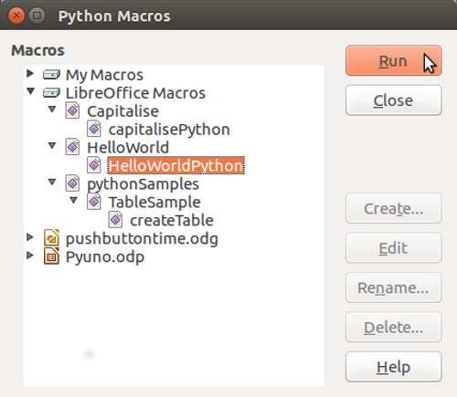
Review the shared python macro's...

Slide 5
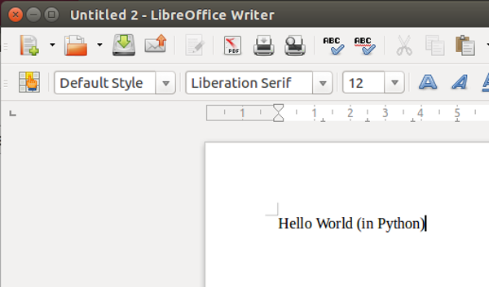
Shared Python Script “HelloWorld.py”, having executed function HelloWorldPython(), launches Writer and displays Hello World...

Slide 6
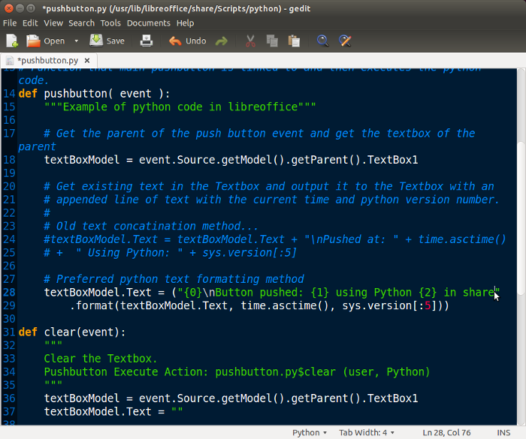
Edit python file (add “in share”) to observe difference...

Slide 7
Copy example python file to libreoffice python scripts shared folder...
~/==> sudo cp ~/.config/libreoffice/4/user/Scripts/python/pushbutton.py /usr/lib/libreoffice/share/Scripts/python/
~/==> ls -lR /usr/lib/libreoffice/share/Scripts/python/
/usr/lib/libreoffice/share/Scripts/python/:
total 16
-rw-r--r-- 1 root root 3333 Oct 16 13:25 Capitalise.py
-rw-r--r-- 1 root root 1539 Oct 16 13:25 HelloWorld.py
-rw-r--r-- 1 root root 2112 Apr 4 10:33 pushbutton.py
drwxr-xr-x 2 root root 4096 Apr 4 10:33 pythonSamples
/usr/lib/libreoffice/share/Scripts/python/pythonSamples:
total 8
-rw-r--r-- 1 root root 4491 Oct 16 13:25 TableSample.py
~/==>

Slide 8
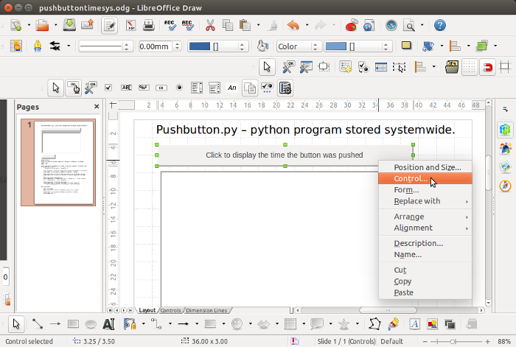
Save original Draw document with a new name.
Then start performing the steps to change the push buttons to link to shared python file functions...

Slide 9
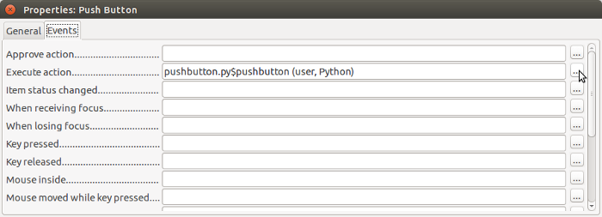
Execute Action for User account

Slide 10
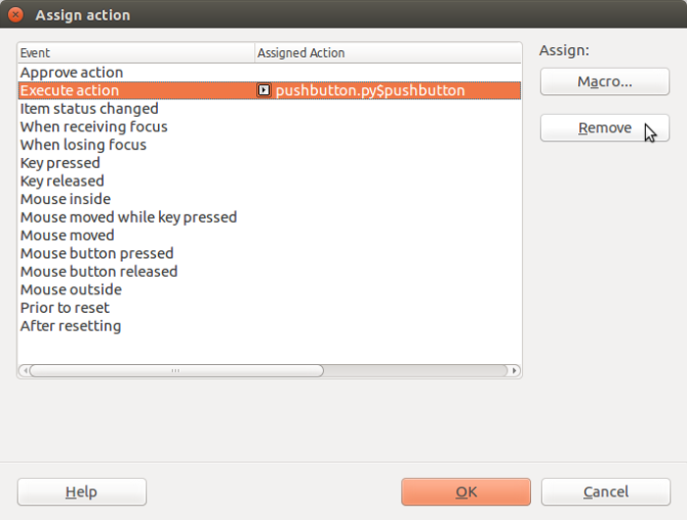
Remove the current push button link

Slide 11
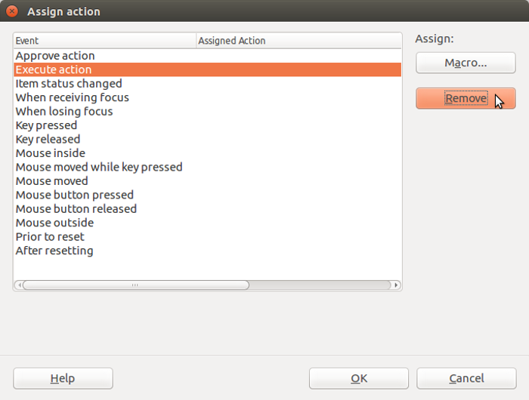
Assigned action removed now assign new Macro

Slide 12
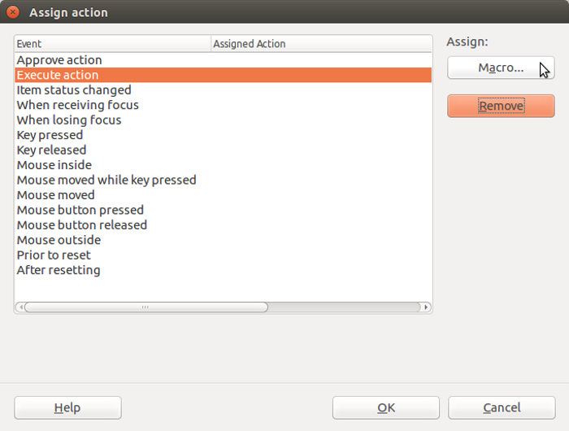
For Execute Action, select Macro...

Slide 13
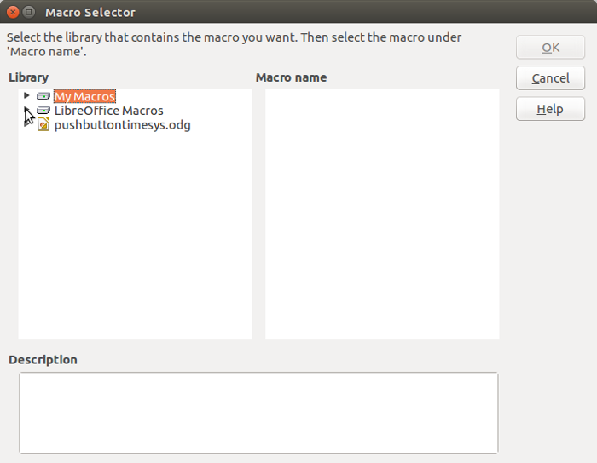
Open the Shared Library of Python programs...

Slide 14
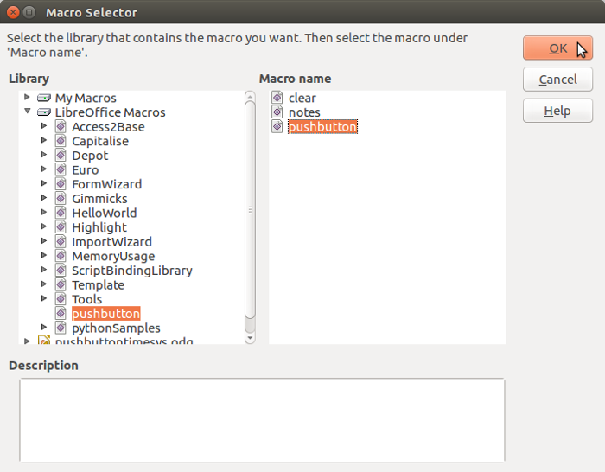
From pushbutton.py select function pushbutton()

Slide 15
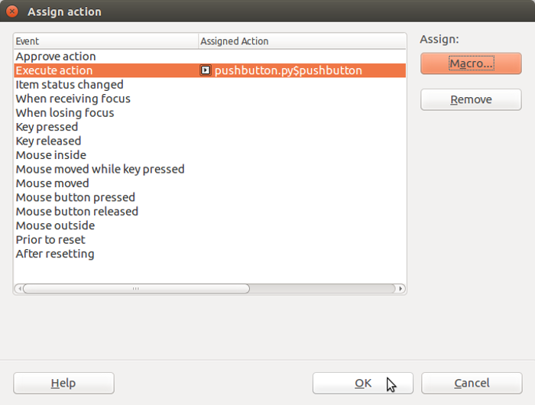
Pushbutton() now assigned action...

Slide 16
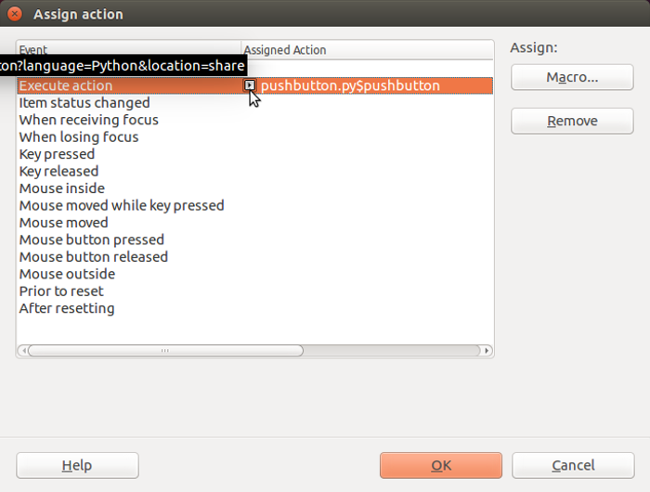
Highlighter show location is now “share”. (Was “user”)

Slide 17
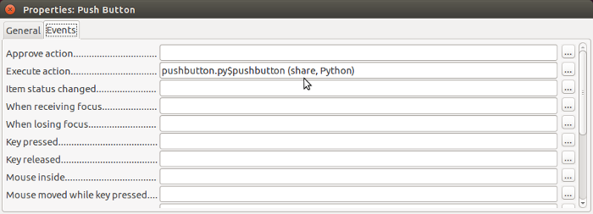
Execute Action changed to “share”...

Slide 18
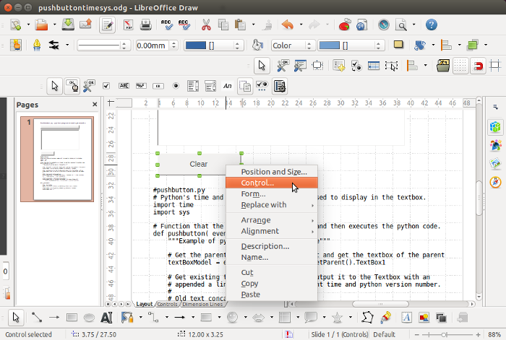
Perform the same changes for the “clear” pushbutton...

Slide 19
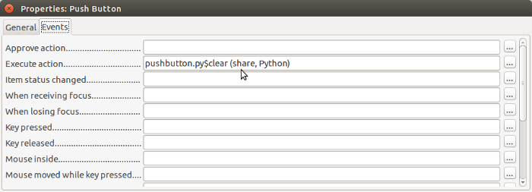
Assigned Action for “clear” button now set to share...

Slide 20
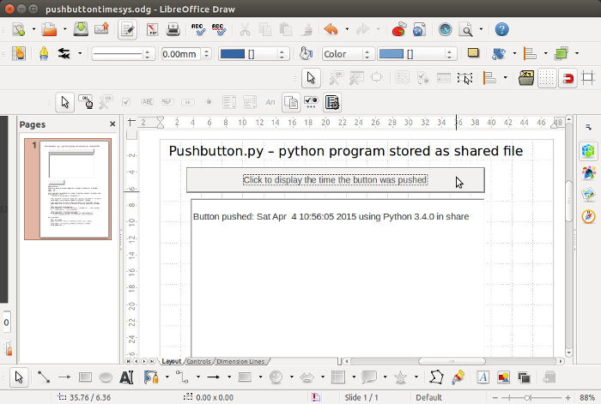
Push button now executes the shared python program...

Slide 21
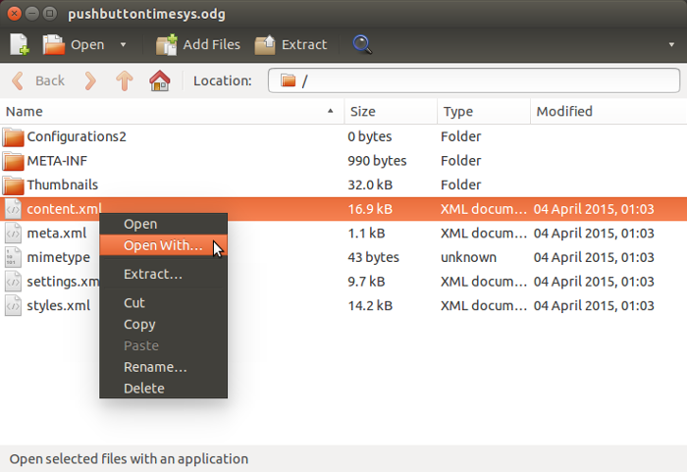
Examine the content.xml in the Draw document...

Slide 22
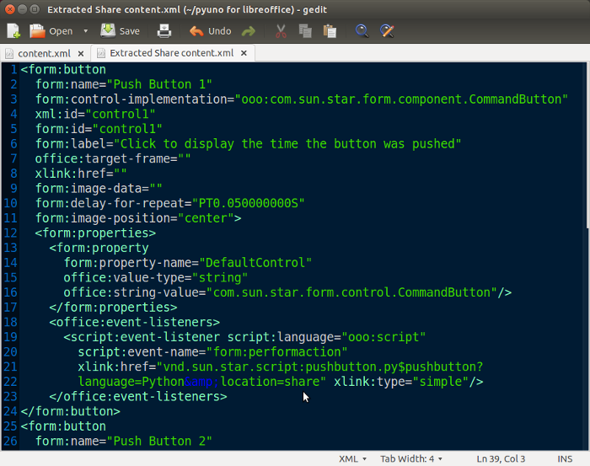
Location is now “share”...

Slide 23
End of reviewing a python program in the shared library.
Goto Part 4 for embedding a python program file in a libreoffice document.

